Slide 1

NLP : Recurrent Neural Network
Video 5: Word Embedding

Slide 2



Beyond Basic Vectorization Techniques
Count Vectorization & TF-IDF
Bag of words Models
Sequence based Models

Slide 3

Vectorization
One Hot Encoding
Countvectorizer
TF-IDF
Word Embedding

Slide 4
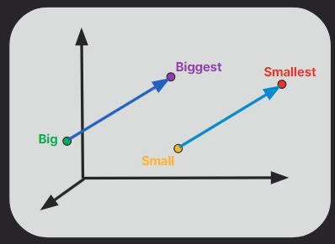
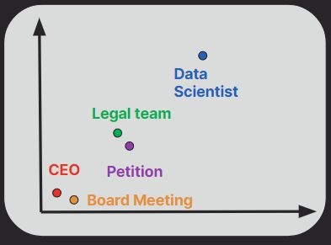
Word Embedding
Represents words as vectors of dimensions in a way that captures their meanings, relationships, and context.
Vectors
CEO = [0.2, -0.7,......,0.6]
CTO = [0.5, -0.6,......,0.7]

Slide 5




Word Embedding
Word Embedding Methods
Word2Vec
fastText
GloVe

Slide 6


Word Embedding
Word Embedding Methods
Word2Vec
Developed by Google in 2013
fastText
GloVe
Continuous Bag of Words (CBOW)
Skip-Gram

Slide 7
Continuous Bag of Words
“The CEO delivered a compelling presentation at the board meeting.”

Slide 8
Continuous Bag of Words
Takes context words as input and predicts the most likely outcome or word to complete the missing part of sentence.
“The CEO delivered a compelling at the board meeting.”
speech
idea
presentation
thought

Slide 9
Continuous Bag of Words
“The CEO delivered a compelling at the board meeting.”
Input | Target
delivered | presentation
compelling | presentation
board meeting | presentation
speech
idea
presentation
thought

Slide 10


Continuous Bag of Words Model
Input Layer
Context words
Output Layer
Predict the target word
Projection Layer
Word embeddings

Slide 11
Continuous Bag of Words Model
Softmax function
Output Layer

Slide 12
Word Embedding
Word Embedding Methods
Word2Vec
fastText
GloVe
Continuous Bag of Words (CBOW) Skip-Gram

Slide 13
Skip-Gram
Starts with a target word and uses it to predict the surrounding context words.
“The CEO delivered a compelling presentation at the board meeting.”
Input | Target
presentation | delivered
presentation | compelling
presentation | board meeting

Slide 14
Word Embedding
Word Embedding Methods
Word2Vec
fastText
GloVe

Slide 15
2. GloVe
Stands for Global Vectors.
Developed by Stanford University researchers.
Analyzes frequency of words and assigns similar numerical vectors.

Slide 16
2. GloVe : Building the Co-occurrence Matrix
“The CEO delivered compelling presentation at the board meeting.”
Window size = 1
 | CEO | delivered | compelling | presentation | board
CEO | 0 | 1 | 0 | 0 | 0
delivered | 1 | 0 | 1 | 0 | 0
compelling | 0 | 1 | 0 | 1 | 0
presentation | 0 | 0 | 1 | 0 | 0
board | 0 | 0 | 0 | 0 | 0

Slide 17
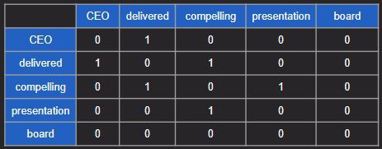
2. GloVe
Calculate probabilities ratios

Slide 18
2. GloVe
Calculate probabilities ratios
Cost function approximates ratios by using the dot of word vectors.

Slide 19
2. GloVe
Calculate probabilities ratios
Cost function approximates ratios by using the dot of word vectors.
Adjust word vectors by minimizing cost function

Slide 20
Word Embedding
Word Embedding Methods
Word2Vec
fastText
GloVe

Slide 21
3. fastText
Developed by Google in 2015
Enhances word embeddings by using sub-word units like n-grams of characters within words.
Extends the Word2Vec model to handle rare, new, or misspelled words.
“Playing”
“Pl”
“Pla”
“Play”
“layi”
“aying”

Slide 22
Word Embedding
Word Embedding Methods
Word2Vec
fastText
GloVe

Slide 23
Word Embedding
Word Embedding Methods
Word2Vec
GloVe
Fasttext
ELMo
BERT

Slide 24
4. ELMo
Embedding from language models
Uses bi-directional LSTM models
Pre-trained on large corpus to predict next word based on previous and future words.

Slide 25
5. BERT
Bidirectional Encoder Representations from Transformers
Consider both left and right context of words in a sentence.
Uses Transformer architecture

Slide 26
Up Next: RNN Model in Jupyter

